Slide 1
Lectures 15-19 Integer Arithmetic
SAHANA.P.SHANKAR

Slide 2
Intended Learning Outcomes
At the end of the lectures, the student will be able to
Describe concepts of divisibility and modular arithmetic
Explain congruencies in modular arithmetic and their solution
Explain the properties of primes, GCD and LCM and their calculation
Apply the properties of congruencies, primes, GCD and LCM to solve problems in integer and modular arithmetic
Explain the application of integer and modular arithmetic in computer science domain: Hashing, Random Number Generators, Cryptography and Digital Signatures

Slide 3
Topics
Divisibility and Modular Arithmetic
Prime Numbers, Greatest Common Divisors (GCD) and Euclidean Algorithm
Applications to Computer Science

Slide 4
Section 1: Divisibility and Modular Arithmetic

Slide 5
Section Outline
Divisibility
Division Algorithm
Modular Arithmetic
Congruencies
Pseudo Random Number Generators
Hashing Functions

Slide 6
Introduction
Number Theory is the branch of mathematics that deals with integer numbers and their properties.
We will be covering the following topics:
Divisibility, Modular Arithmetic and their applications
Prime Numbers, their properties and applications

Slide 7
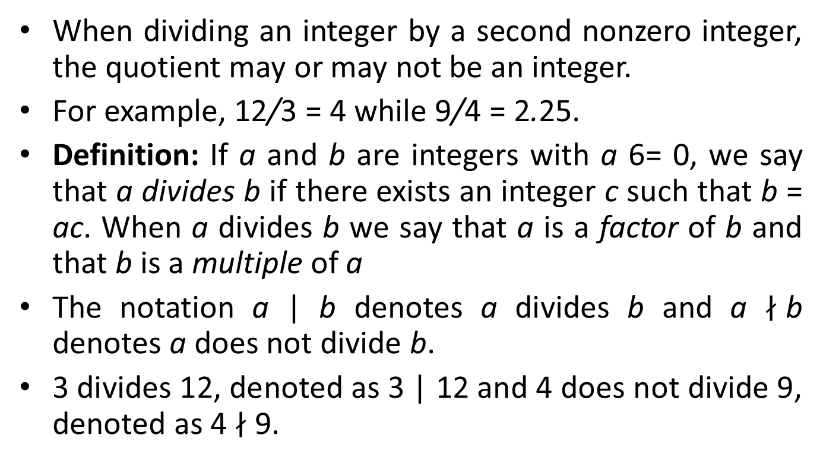
Divisibility
When dividing an integer by a second nonzero integer, the quotient may or may not be an integer.
For example, 12/3 = 4 while 9/4 = 2.25.
Definition: If a and b are integers with a 6= 0, we say that a divides b if there exists an integer c such that b = ac. When a divides b we say that a is a factor of b and that b is a multiple of a
The notation a | b denotes a divides b and a $∤$b denotes a does not divide b.
3 divides 12, denoted as 3 | 12 and 4 does not divide 9, denoted as 4 $∤$9.

Slide 8
Divisibility Properties
Theorem: Let a, b and c be integers. Then,
If a | b and a | c, then a | (b + c)
If a | b then a | bc, for all integers c
If a | b and b | c, then a | c
Corollary: If a and b are integers such that a | b and a | c, then a | mb + nc whenever m and n are integers

Slide 9
Division Algorithm
Theorem (Division Algorithm): Let a be an integer and d a positive integer. Then, there are unique integers q and r, with 0 ≤ r < d, such that a = dq + r
d is called the divisor;
a is called the dividend;
q is called the quotient; this can be expressed q = a div d;
r is called the remainder; this cane be expressed r = a mod d;
Examples:
If a = 7 and d = 3, then q = 2 and r = 1, since 7 = (2)(3) + 1.
If a = −7 and d = 3, then q = −3 and r = 2, since −7 = (−3)(3) + 2.

Slide 10
Division Algorithm
Example: Using successive subtractions, find q and r when a = 101 and d = 11
q = 9 as we subtracted 11, 9 times
r = 2 since this was the last value before getting negative.
Solution:
101
- 11
90
- 11
79
- 11
68
- 11
57
- 11
46
46
- 11
35
- 11
24
- 11
13
- 11
2

Slide 11
Proof of the Division Algorithm
Existence:
Let S be the set of nonnegative integers of the form a - dq, where q is an integer. This set is nonempty because -dq can be made as large as desired (taking q as a negative integer with large absolute value). By the well-ordering property, S has a least element r = a - dq₀ for some integer q₀.
The integer r is nonnegative. It is also the case that r < d; otherwise if r ≥ d, then there would be a smaller nonnegative element in S, namely a – d(q₀ + 1), contradicting the fact that a – dq₀ was the smallest element of S. So, we just proved the existence of r and q, with 0 ≤ r ≤ d.

Slide 12
Proof of the Division Algorithm
Uniqueness:
Suppose there exist q, Q, r, R with 0 ≤ r, R < d, such that a = dq + r and a = dQ + R. Assume without loss of generality that q ≤ Q. Subtracting both inequalities, we have d (q – Q) = (R – r). Thus d | (R – r) and so |d| < |R – r| or R – r = 0. But we know 0 ≤ r, R < d; so |R – r| < d, and we must have R – r = 0. This means R = r, which substituting into original equations gives a – r = dq = dQ. Since d != 0, dividing both sides of dq = dQ by d we get that q = Q. Therefore we have shown R = r and q = Q, proving uniqueness.

Slide 13
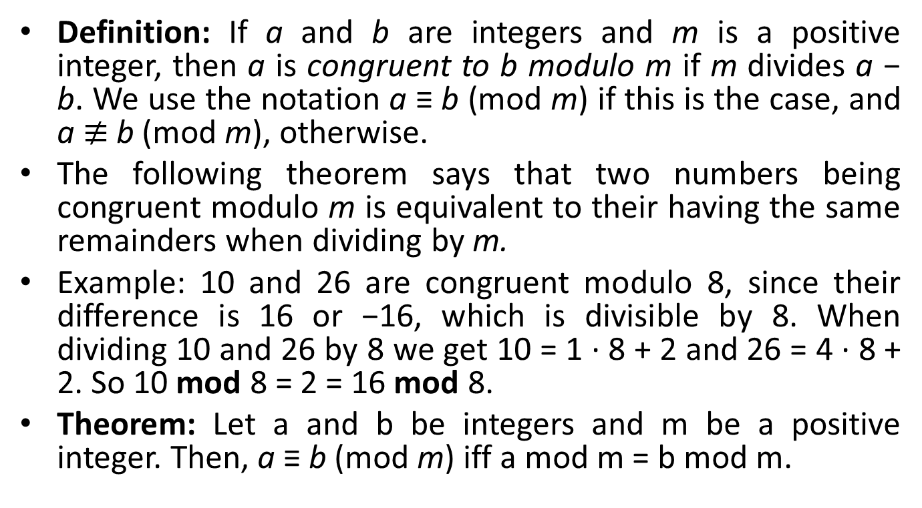
Modular Arithmetic
Definition: If a and b are integers and m is a positive integer, then a is congruent to b modulo m if m divides a − b. We use the notation a ≡ b (mod m) if this is the case, and a $≢$b (mod m), otherwise.
The following theorem says that two numbers being congruent modulo m is equivalent to their having the same remainders when dividing by m.
Example: 10 and 26 are congruent modulo 8, since their difference is 16 or −16, which is divisible by 8. When dividing 10 and 26 by 8 we get 10 = 1 · 8 + 2 and 26 = 4 · 8 + 2. So 10 mod 8 = 2 = 16 mod 8.
Theorem: Let a and b be integers and m be a positive integer. Then, a ≡ b (mod m) iff a mod m = b mod m.

Slide 14

Visualisation of Mod Function
Congruent Classes mod 5
≡ 0 (mod 5)
20
15
≡ 1 (mod 5)
10
≡ 4 (mod 5)
19
5
21
14
16
9
0
11
4
6
1
3
2
8
7
13
12
18
17
22
≡ 3 (mod 5)
≡ 2 (mod 5)

Slide 15
Modular Arithmetic
Theorem 3: Let m be a positive integer. The integers a and b are congruent modulo m if and only if there is an integer k such that a = b + km.
Theorem 4: Let m be a positive integer. If a ≡ b (mod m) and c ≡ d (mod m), then a + c = b + d (mod m) and ac ≡ bd (mod m).

Slide 16
Modular Arithmetic
Corollary: Let m be a positive integer and let a and b be integers. Then,
(a + b) mod m = ((a mod m) + (b mod m)) mod m
ab mod m = ((a mod m)(b mod m)) mod m
Proof: By the definition of mod m and the definition of congruence modulo m, we know that a ≡ (a mod m) (mod m), and b ≡ (b mod m) (mod m). Applying Theorem 5, we get
a + b ≡ (a mod m) + (b mod m) (mod m)
ab ≡ (a mod m)(b mod m) (mod m
Using Theorem 3, from the above congruencies, we get the equalities in the statement of the theorem.

Slide 17
Congruencies and Hashing
A hashing table is a data structure that allows for direct access to data. If done carefully, and under certain assumptions, we can search for a record with a set of n records in expected time O(1).
Each record is uniquely identified by a key (e.g. of keys are student number for a student record, account number for bank account records, call number for book records in a library, etc).
One of the most common hash functions uses modular arithmetic: h(k) = k mod m, where m is the number of memory addresses.
Advantages: easy to compute; function is onto (all memory address can be used).
Since two different integers k₁ and k₂ may be mapped to the same location if k₁ ≡ k₂ (mod m), collisions may arises. Methods for finding an alternate location for a key are employed (collision resolution techniques).

Slide 18
Congruencies and Pseudorandom Number Generators
We need random numbers in several types of algorithms, such as:
Randomized algorithms (algorithms that need to flip a coin to behave unbiasedly),
Simulation algorithms: where probability models are used to explain behaviour (example: arrival rate of subway passengers).
A systematic method of generating a number cannot be truly random, so we call them pseudorandom number generators.
The most common method for such generators is the linear congruential method.
Pick integers a, c, m and seed x₀, with 2 ≤ a < m, 0 ≤ c,x₀ < m.
Generate a sequence of numbers x₀,x₁,x₂,... from the seed x₀, using the congruence:
x_{n+1} = (ax_{n} + c) mod m.

Slide 19
Congruencies and Pseudorandom Number Generators
The length of the period before repeats is called the period.
Of course the period is at most m, and sometimes is exactly m.
For this reason m must be large.
If we need a number in [0, 1] we simply provide x_{n}/m

Slide 20
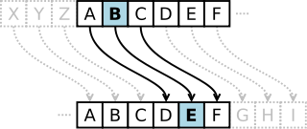

Congruencies and Cryptography
Cryptology is the study of secret messages.
One of its early uses was by Roman emperor Julius Caesar.
The Caesar Cipher shifted each letter 3 letters forward in the alphabet (cyclically, sending xyz to abc respectively):
We can express the Caesar cipher mathematically using modular arithmetic (and generalizing the shift by 3 to a shift by k):
Encryption function: f(p) = (p + k) mod 26.
Decryption function:

Slide 21
Section 2: Primes

Slide 22
Section Outline
Prime Numbers
Fundamental Theorem of Algebra
GCD and LCM
Euclid’s GCD Algorithm
Extended Euclid’s Algorithm
Solving Linear Congruencies
Chinese Remainder Theorem
Fermat’s Little Theorem

Slide 23
Primes
Definition: A positive integer p > 1 is called prime if the only positive factors of p are 1 and p. A positive integer that is greater than one and is not prime is called composite.
Primes: 2, 3, 5, 7, 11, 13, 17, etc.
Composite Numbers: 4, 6, 8, 9, 10, 12, 14, 15, etc.

Slide 24
Fundamental Theorem of Algebra
Theorem: Every positive integer greater than 1 can be written uniquely as a prime or as the product of two or more primes where the prime factors are written in order of nondecreasing size.
Examples:
100 | = | 2 · 2 · 5 · 5 = 2² · 5²
641 | = | 641
333 | = | 3 · 3 · 37 = 3² · 37
64 | = | 2 · 2 · 2 · 2 · 2 · 2 = 2⁶

Slide 25
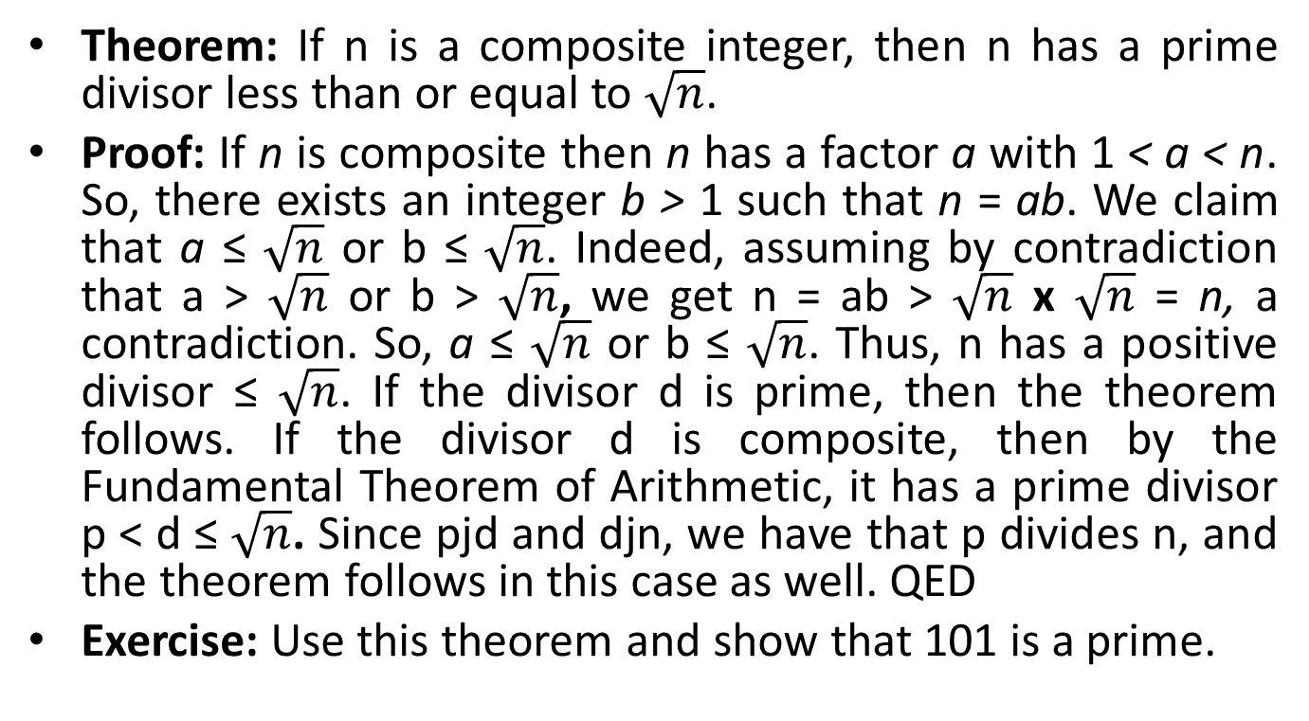
Largest Prime Divisor
Theorem: If n is a composite integer, then n has a prime divisor less than or equal to $\sqrt{n}$.
Proof: If n is composite then n has a factor a with 1 < a < n. So, there exists an integer b > 1 such that n = ab. We claim that a ≤ $\sqrt{n}$ or b ≤ $\sqrt{n}$. Indeed, assuming by contradiction that a > $\sqrt{n}$ or b > $\sqrt{n}$, we get n = ab > $\sqrt{n}$ x $\sqrt{n}$ = n, a contradiction. So, a ≤ $\sqrt{n}$ or b ≤ $\sqrt{n}$. Thus, n has a positive divisor ≤ $\sqrt{n}$. If the divisor d is prime, then the theorem follows. If the divisor d is composite, then by the Fundamental Theorem of Arithmetic, it has a prime divisor p < d ≤ $\sqrt{n}$. Since pjd and djn, we have that p divides n, and the theorem follows in this case as well. QED
Exercise: Use this theorem and show that 101 is a prime.

Slide 26
Infiniteness of Primes
Theorem: There are infinitely many primes.
Proof: We will use a proof by contradiction. Assume there are finitely many primes: p₁,p₂,...,p_{n}. Let Q = p₁p₂ ···p_{n} + 1. By the Fundamental Theorem of Arithmetic, Q is prime or it can be written as the product of two or more primes. In either case, there exists a prime p such that p|Q. We claim this prime p cannot be any of the p_{i} with 1 ≤ i ≤ n. Indeed, if p_{i}|Q, we would conclude that p_{i}|(Q − p₁p₂ ···p_{n}) = 1, which is a contradiction. Therefore, we conclude that p is a prime, and is not any of the primes listed p₁,p₂,...,p_{n}. But we have assumed that this was a complete list of all existing primes, and we reached a contradiction.

Slide 27
Greatest Common Divisor (GCD)
Definition: Let a and b be integers, not both zero. The largest integer d such that d|a and d|b is called the greatest common divisor of a and b, and is denoted by gcd(a, b).
Example: The positive common divisors of 24 and 36 are 1,2,3,4,6,12. So, gcd(24, 36) = 12
Exercise: Find the following greatest common divisors:
gcd(17, 100)
gcd(1000, 625)

Slide 28
Relatively Prime
Definition: The integers a and b are relatively prime if gcd(a, b) = 1.
Example: 8 and 9 are relatively prime as gcd(8, 9) = 1 (Indeed, 8 = 2³ and 9 = 3²; thus their only common divisor is 1)
Exercise: Are the following numbers relatively prime?
3 and 12
1024 and 625
7 and 15

Slide 29
Prime Factorisation
Proposition:

Slide 30
Prime Factorisation
Proof: First note that the integer on the RHS of the last equation divides a and b. since the power of each prime p_{i} does not exceed the power of p_{i} appearing in the factorization of each of these numbers. Second, the exponents of p_{i} in d cannot be increased, otherwise it would not divide one of a or b, and no other prime can be included.
Example: 120 = 2³ · 3 · 5 and 500 = 2² · 5³, so gcd(120,500) = 2² · 3⁰ · 5³ = 20.

Slide 31
Least Common Multiple (LCM)
Definition: The least common multiple of the positive integers a and b is the smallest positive integer that is divisible by both a and b, denoted by lcm(a, b).
Examples: lcm(2,10) = 10, lcm(5,7) = 35, lcm(4,6) = 12.

Slide 32
Integer Product, GCD and LCM
Theorem: Let a and b be integers. Then, ab = gcd(a, b) x lcm(a, b).

Slide 33
Euclid’s Algorithm
The methods described in Proposition 1 to calculate gcd(a,b) via the prime factorization of a and b is not efficient.
For instance, we do not know how to efficiently factor a number; that is, there are no polynomial time algorithm known that does this job. Since that method requires factoring a and b, we would need to use algorithms that do not run in polynomial time (exponential or sub-exponential time).
Note that here the input size is blog₂ ac + blog₂ bc (number of bits needed to represent a and b). An algorithm running in linear time with a and b would not be a polynomial time algorithm.
However, there is an efficient algorithm which uses only O(log(min(a,b))) integer divisions.
This algorithm was invented by Euclid, the famous mathematician who lived during 325-265 B.C.

Slide 34
Euclid’s Algorithm
We want to calculate the gcd(91,287).
Applying the division algorithm to 287 and 91, we get 287 = 91 · 3 + 14.
Any common divisor d of 287 and 91 must also be a divisor of 14, because d|287 and d|91 implies d|(287 − 91 · 3) = 14.
Also, any common divisor of 91 and 14 must also be a divisor of 287. So, gcd(287,91) = gcd(91,14).
We’ve just decreased one of the numbers.
Continue the process by dividing 91 by 14: 91 = 14 · 6 + 7.
Again, we conclude gcd(91,14)=gcd(14,7), and divide 14 by 7:
14 = 7 · 2 + 0
Because 7 divides 14 we know gcd(14,7) = 7. Therefore, gcd(287,91) =gcd(91,14) =gcd(14,7) = 7.

Slide 35
Euclid’s Algorithm
Euclid’s Algorithm is based on the following
Lemma: Let a = bq + r where a, b, q, r are integers. Then, gcd(a, b) = gcd(b, r).
Proof: It is enough to show that the common divisors of a and b are the same as the common divisors of b and r, for then they will also share the greatest common divisor. Suppose d|a and d|b. Then d|a − bq = r. So any common divisor of a and b is also a common divisor of b and r. Suppose d|b and d|r. Then d|bq + r = a So, any common divisor of b and r is a common divisor of a and b. Therefore, gcd(a,b) =gcd(b,r).

Slide 36
Euclid’s Algorithm
Correctness: partial correctness + termination

Slide 37
Euclid’s Algorithm
gcd(123, 277)

Slide 38
Extended Euclid’s Algorithm
Theorem: If a and b are positive integers, then there exist integers s and t such that gcd(a, b) = sa + tb.
Example: gcd(252,198) = 18 = 4 · 252 − 5 · 198
Now will show a method for computing s and t called the Extended Euclidean Algorithm

Slide 39
Extended Euclid’s Algorithm
Consider the steps of the Euclidean algorithm for gcd(252,198):
Isolate the nonzero remainders in the above equations, substituting backwards:
Therefore, gcd(252,198) = 4 · 252 − 5 · 198

Slide 40
Useful Results
Lemma A: If a and b are positive integers such as gcd(a, b) = 1 and a | bc, then a | c
Proof: Using Extended Euclidean Algorithm, there exists s and t such that sa + tb = 1 = gcd(a,b). Multiplying by c, we get sac + tbc = c. Since a|bc then a|tbc. But then by the above equation since a|sac and a|tbc, we get that a|c.
The above Lemma generalizes to the following:
Lemma B: If p is a prime and p | a₁ a₂ … a_{n} where each a_{i} is an integer, then, p | a_{i} for some i.

Slide 41
Dividing Both Sides of a Congruence
As we have seen, we can’t always divide both sides of a congruence by the same integer, even if it is non-zero.
For example:
6 ≡ 12 (mod 6), but 36 ≡ 6 (mod 6).
14 ≡ 8 (mod 6), but 76≡ 4 (mod 6).
However, we can divide by appropriate integers c, as long as gcd(c, m) = 1:
Theorem: Let m be a positive integer and let a, b and c be integers. If ac ≡ bc (mod m) and gcd(c, m) = 1, then a ≡ b (mod m).
Proof: Since ac ≡ bc (mod m) we have that m|ac − bc = c(a − b). By Lemma A, since gcd(c, m) = 1, we have that c|(a − b). This gives a ≡ b (mod m).

Slide 42
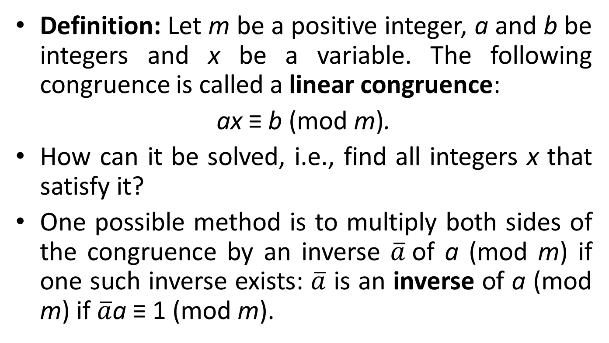
Solving Linear Congruence
Definition: Let m be a positive integer, a and b be integers and x be a variable. The following congruence is called a linear congruence:
ax ≡ b (mod m).
How can it be solved, i.e., find all integers x that satisfy it?
One possible method is to multiply both sides of the congruence by an inverse $\overline{a}$of a (mod m) if one such inverse exists: $\overline{a}$ is an inverse of a (mod m) if $\overline{a}$a ≡ 1 (mod m).

Slide 43
Solving Linear Congruence
Example: 5 is an inverse of 3 (mod 7), since 5 · 3 ≡ 15 ≡ 1 (mod 7). Using this we can solve:
Substitute back into the original linear congruence to check that 6 is a solution:
3 · 6 ≡ 18 ≡ 4 (mod 7).
But how do we compute the inverses (mod m)?

Slide 44
Computing Inverses Modulo m
Theorem: If a and m are relatively prime integers with m > 1, then an inverse of a modulo m exists. Furthermore, this inverse is unique modulo m.
Proof: By Theorem A, since gcd(a,m) = 1, there exists s and t such that sa + tm = 1. This implies sa + tm ≡ 1 (mod m). Since tm ≡ 0 (mod m), so sa ≡ 1 (mod m), which implies s is an inverse of a modulo m. It remains to show that this inverse is unique modulo m. Suppose s and s⁰ are inverses of a modulo m. Then, sa ≡ 1 ≡ s⁰a (mod m). Since gcd(a,m) = 1, by Theorem B, we can divide both sides of the congruence by a, obtaining s ≡ s⁰ (mod m).

Slide 45
Computing Inverses Modulo m
Example: Inverse of 24 modulo 7. Applying the extended Euclidean Algorithm:
24 = 3x7 + 3
7 = 2x3 + 1
3 = 3x1 + 0
Using backward substitution:
1 = 7 − 2 · 3 = 7 − 2 · (24 − 3 · 7) = −2 · 24 + 7 · 7.
So s = −2 and t = 7.
−2 · 24 ≡ 1 (mod 7)
We can use as an inverse of 24 modulo 7, any integer equivalent to −2 modulo 7, such as: ...,−9,−2,5,12,19,...

Slide 46
Solving System of Congruencies: Chinese Remainder Theorem
A Chinese Mathematician asked in the first century:
There are certain things whose number is unknown. When divided by 3, the remainder is 2; when divided by 5 the remainder is 3; and when divided by 7, the remainder is 2. What will be the number of things?
This puzzle is asking for the solution of the following system of congruencies:
x ≡ 2 (mod 3)
x ≡ 3 (mod 5)
x ≡ 2 (mod 7)
The Chinese Remainder Theorem establishes that when the moduli are pairwise relatively prime, we can solve such as system of linear congruencies uniquely module the product of the moduli.

Slide 47
Chinese Remainder Theorem
Theorem (Chinese Remainder Theorem): Let m₁ m₂ … m_{n} be pairwise relatively prime positive integers and a₁ a₂ … a_{n} be arbitrary integers. Then, the system of congruencies:
x ≡ a₁ (mod m₁)
x ≡ a₂ (mod m₂)
…
x ≡ a_{n} (mod a_{n})
has a unique solution module m = m₂ … m_{n}.
That is, there is a solution 0 ≤ x ≤ m, and all other solutions are congruent module m to x.

Slide 48
Chinese Remainder Theorem
Proof:
(Existence): In order to construct a simultaneous solution, let M_{k} = m/m_{k}. Note that gcd(m_{k},M_{k}) = 1. So there exists y_{k} inverse of M_{k} modulo m_{k}. Then x = a₁M₁y₁ + a₂M₂y₂ + ··· + a_{n}M_{n}y_{n} is a simultaneous solution. Indeed, for any 1 ≤ k ≤ n, since for j 6= k, all terms except kth term are 0 modulo m_{k}, which gives x ≡ a₂M_{k}y_{k} ≡ a_{k} (mod m_{k}).
(Uniqueness): Exercise

Slide 49
Chinese Remainder Theorem
Solving the original old question, that asks for a simultaneous solution to x ≡ 2 (mod 3), x ≡ 3 (mod 5), x ≡ 2 (mod 7). m₁ = 3, m₂ = 5, m₃ = 7, so m = m₁m₂m₃ = 105. a₁ = 2, a₂ = 3, a₃ = 2;
M₁ = 35, an inverse of 35 modulo 3: 2 M₂ = 21, an inverse of 21 modulo 5: 1 M₃ = 15. an inverse of 35 modulo 3: 1
So the solution x ≡ a₁M₁y₁ + a₂M₂y₂ + a₃M₃y₃ ≡ 2 · 25 · 2 + 3 · 21 · 1 + 2 · 15 · 1 ≡ 233 ≡ 23 (mod 105).

Slide 50
Fermat’s Little Theorem
Theorem (Fermat’s Little Theorem): If p is a prime and a is an integer not divisible by p, then a^{p-1} ≡ 1 (mod p). Furthermore, for every integer a we have a^{p} ≡ a (mod p).
Example: p = 5. Verify that the theorem works for a = 1,2,3,4.
Solution: For 1 it is trivial, 2⁴ = 16 ≡ 1 (mod 5), 3⁴ = 81 ≡ 1 (mod 5), 4⁴ = 256 ≡ 1 (mod 5).

Slide 51
Section 3: Applications

Slide 52
Section Outline
Public Key Cryptography
RSA Cryptosystem
Digital Signatures

Slide 53
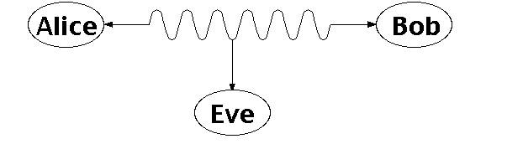
Public Key Cryptography
Two people, say Alice and Bob, would like to exchange secret messages; however, Eve is eavesdropping:

Slide 54
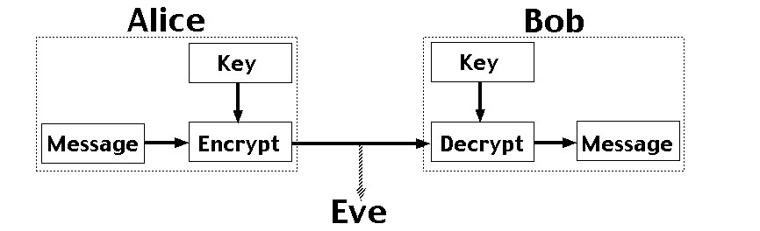
Public Key Cryptography
One technique would be to use an encryption technique based on an encryption key, but this poses a challenge: how do they exchange the encryption key without Eve receiving it?

Slide 55
Traditional Cryptography
In normal cryptography, both parties need to know a secret key k. The sender then encodes message m using key k via some method f to get the ciphertext c: c = f(m,k).
Then, the receiver decodes the ciphertext c using key k via some method g to get back the original message m: m = g(c,k).
The issue here is how to securely exchange the secret key k.
If we could find a method of encryption / decryption such that exchanging the necessary keys does not reveal to Eve how to decrypt intercepted messages, then we would avoid this problem altogether.

Slide 56
Public Key Cryptosystem
The idea is that the receiver publically publishes a public key k. Then anyone who wishes to encode a message m can do so: c = f(m,k).
The receiver has a private key k⁰ that is needed to decode the ciphertext c to receive the original message m: m = g(c,k).
Both the encoding technique f and the decoding technique g are also publically known; the only secret information is k⁰.
While it is possible, it is computationally difficult to compute k⁰ from k: the key pair can be chosen so that in the amount of time it takes to derive k⁰ from k, the information m no longer has significant value

Slide 57
RSA Cryptosystem
The most common form of public key cryptosystem is RSA, which stands for Rivest, Shamir, and Adleman, who invented it. It is based on modular arithmetic and large primes, and its security comes from the computational difficulty of factoring large numbers.
The idea is as follows: Select p and q to be large primes (at least several hundred digits); the degree of security is dependent on the size of p and q. Take n = pq.
Then the public key is a pair k = (n,e) such that: gcd(e,(p − 1)(q − 1)) = 1.
The encoding function is: f(m,k) ≡ m^{e} (mod n).
This assumes that the message can be represented by an integer m < n with gcd(m,p) = gcd(m,q) = 1; if not, we can break m down into smaller pieces and encode each individually.

Slide 58
RSA Cryptosystem
The private key is a pair k⁰ = (n,d) such that: de ≡ 1 (mod (p − 1)(q − 1)).
The decoding function is: g(c,k⁰) = c^{d} (mod n).
The security of the algorithm lies in the challenge of prime factorization: in order to calculate d, it is necessary to factor n to get p and q, which is very difficult (exponential in the number of digits in p and q).
Now we proceed to show that RSA actually works.

Slide 59
Proof of RSA Cryptosystem
Theorem (RSA Cryptosystem):

Slide 60
Proof of RSA Cryptosystem
Proof:

Slide 61
RSA Cryptosystem
Example: Bob wants to receive messages from Alice, so he selects two primes, say p = 43 and q = 59. (We choose small primes for feasibility of the example; in reality, they would be vastly larger.)
Then n = pq = 2537 and (p − 1)(q − 1) = 2436. He then picks e = 13, which has the property that: gcd(e,(p − 1)(q − 1)) = gcd(13,2436) = 1.
Bob then calculates d = 937, the inverse of e mod 2436: de ≡ 937 × 13 ≡ 12181 ≡ 5 × 2436 + 1 ≡ 1 (mod 2436).
Bob publishes the public key k = (2537,13).
Alice wants to send message “STOP” to Bob using RSA. She encodes this: S → 18, T → 19, O → 14, P → 15, i.e. 1819 1415 grouped into blocks of 4.
Thus, m = m₁m₂ = 18191415. Each block is encrypted:
1819¹³ mod 2537 = 2081
1451¹³ mod 2537 = 2182
Then the encrypted message is 20812182. Bob has private key k⁰ = (2537,937), and computes:
2081⁹³⁷ mod 2537 = 1819 → ST
2812⁹³⁷ mod 2537 = 1415 → OP
Thus, the original message was STOP

Slide 62
Digital Signature Systems
Note that we can apply the same argument to show that: f(g(m,k⁰),k) = m.
Thus, the owner of the private key can encrypt a message m using the private key, which can then be decrypted by anyone using the public key, and prove that only the private key owner could have encrypted it.
This is the basis of digital signature systems.

Slide 63
Summary
Number Theory deals with integer numbers and their properties
Divisibility is a fundamental notion that ties many aspects of Number Theory
Modular Arithmetic deals with arithmetic modulo a given integer
Prime Numbers and their properties are extensively used in Number Theory
Modular Arithmetic is employed in Hashing and Random Number generation
Prime Numbers and their properties are employed in Cryptography including Public Key Cryptography (such as RSA) and Digital Signatures

